Slide 1
PHP: Introduction

Slide 2
Topics Covered
Server side web programming
  Client/Server systems
  Comparison with static HTML
PHP - what is it? What does it do?
PHP Language basics
  Syntax
  Variables, Constants, Operators
  Decision making
PHP and the client
Notes:
Server side programming adds a slightly different dimension to ‘standard’ programming encountered at level 1, which generally consists of desktop applications. The server request/response model is introduced to demonstrate how all script is run at once and output is generated.
Students new to server side scripting will be given an overview of how PHP works, and where it fits into the client/server request/response model. This should also serve as a good refresher for those who have done some scripting prior to this module.
Finally, the lecture delivers the language basics of PHP, the common constructs typical of most powerful programming languages, that are necessary building blocks for any application. Such topics include the syntax, variables, constants, operators and decision making (branching). With this basic knowledge introduced, how this relates to the XHTML they have done so far.

Slide 3
Client/Server on the WWW
Standard web sites operate on a request/response basis
A user requests a resource E.g. HTML document
Server responds by delivering the document to the client
The client processes the document and displays it to user
Notes:
Ordinarily the client/response model merely serves a text file over the HTTP protocol to the user agent application, which then renders the output appropriately. The protocol is inherently stateless (meaning that each request/response is dealt with individually).

Slide 4
Server Side Programming
Provides web site developers to utilise resources on the web server
Non-public resources do not require direct access from the clients
Allows web sites to be client agnostic (unless JavaScript is used also)
Most server side programming script is embedded within markup (although does not have to be, sometimes better not to)

Slide 5
PHP - What is it / does it do?
PHP: PHP Hypertext Pre-processor
Programming language that is interpreted and executed on the server
Execution is done before delivering content to the client
Contains a vast library of functionality that programmers can harness
Executes entirely on the server, requiring no specific features from the client

Slide 6



Three-tiered Web
Site: LAMP
Server
Apache HTTP Server
Client
User-agent: Firefox
example request
GET / HTTP/1.1
Host: www.tamk.fi
User-Agent:
...
Mozilla/5.0
(Mac..)
response
PHP
Database
MySQL

Slide 7
Server Side Techniques
Server side scripting requires installation on the server side
Typically client siis only xhtml and it unaware that the xhtml was produced by a server side script
Does not require any installations or add-ons on the client
•
•
•

Slide 8
Server Side
Techniques
•
•
•
•
•
•
PHP
Java EE: Servlet, JSP
.NET
CGI / Perl (Very old)
Ruby
…

Slide 9
Client Side Techniques
Requires that the client supports the technique
JavaScript, Applet, Flash…
•
•

Slide 10
Web Application Frameworks
A web application framework is a software framework that is designed to support the development of dynamic websites, Web applications and Web services.
Numerous frameworks available for many languages
•
•

Slide 11


PHP - What is it / does it do?
Static resources such as regular HTML are simply output to the client from the server
Dynamic resources such as PHP scripts are processed on the server prior to being output to the client
PHP has the capability of connecting to many database systems making the entire process transparent to the client
Web Page Request
Load PHP File
PHP Engine –
Run Script
HTML Response
PHP Results

Slide 12
PHP Summary
PHP: PHP Hypertext Pre-processor
Interpreted and executed by the server on page request
Returns simple output to the client
Provides a tremendous amount of functionality to programmers
Can connect transparently to many database systems

Slide 13
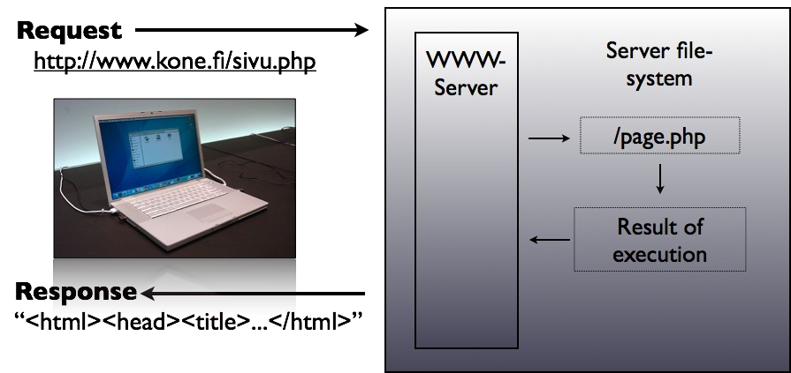
Response

Slide 14
PHP Language Basics
Look at the building blocks of the PHP language
  Syntax and structure
  Variables, constants and operators
  Data types and conversions
  Decision making IF and switch
  Interacting with the client application (HTML forms)

Slide 15
PHP - Syntax and Structure
PHP is similar to C
All scripts start with <?php and with with ?>
Line separator: ; (semi-colon)
Code block: { //code here } (brace brackets)
White space is generally ignored (not in strings)
Comments are created using:
  // single line quote
  /* Multiple line block quote */
Precedence
  Enforced using parentheses
  E.g. $sum = 5 + 3 * 6; // would equal 23
  $sum = (5 + 3) * 6; // would equal 48

Slide 16
PHP - Variables
Prefixed with a $
Assign values with = operator
Example: $author = “Trevor Adams”;
No need to define type
Variable names are case sensitive
  $author and $Author are different

Slide 17
Variables
Variables in PHP are represented sign
PHP supports eight types:
•
by a dollar
•
– boolean, integer, float, double, array, object,
resource and NULL

Slide 18
Example
(php.net)
<?php
$a_bool
$a_str
$a_str2
$an_int
=
=
=
=
TRUE;
"foo";
'foo';
12;
//
//
//
//
a
a
a
boolean
string
string
an integer
echo gettype($a_bool); //
prints out:
prints out:
boolean
string
echo gettype($a_str);
//
//
if
If this is an integer,
(is_int($an_int)) {
$an_int += 4;
increment it
by four
}
//
//
if
If $bool is a string, print it out
(does not print out anything)
(is_string($a_bool)) {
echo "String: $a_bool";
}
?>

Slide 19
PHP - Example Script
<?php
  $author = “Trevor Adams”;
  $msg = “Hello world!”;
  echo $author . “ says ” . $msg;
?>

Slide 20
PHP - Constants
Constants are special variables that cannot be changed
Use them for named items that will not change
Created using a define function
  define(‘milestokm’, 1.6);
  Used without $
  $km = 5 * milestokm;

Slide 21
Naming
Case-sensitivity
Start with letter or _
Variables
•
•
•
After that you can have numbers,
letters
and
_
–
–
–
–
–
$var = 'Bob';
$Var = 'Joe';
print "$var, $Var";
$4site
=
'not
yet';
$_4site = 'not yet';

Slide 22
Magic Constants
PHP has lot of predefined variables
Also predefined constants:
•
•
–
–
–
–
–
LINE
FILE
FUNCTION
CLASS
METHOD
•
See:
http://fi.php.net/manual/en/language.constants.pred efined.php

Slide 23
Scope
<?php
$a
=
"Pekka";
print
?>
”My
name
is
"
.
$a;

Slide 24
Scope
<?php
$a
=
"Pekka";
function
print
}
Test()
$a;
{
print
”My
name
is
”;
Test();
?>

Slide 25
Scope
<?php
$a
=
"Pekka";
function
global
print
}
Test()
$a;
{
$a;
print
”My
name
is
”;
Test();
?>

Slide 26
Control
If, else, elseif, switch
while, do-while, for
foreach
break, continue
Structures
•
•
•
•
•

Slide 27
PHP BASICS

Slide 28
Strings
•
•
Single quoted: 'this
Double quoted: "this
$variable"
Heredoc:
is
is
a
a
$variable'
•
–
–
–
–
–
$str = <<<EOD
Example of string
spanning multiple lines
using heredoc syntax.
EOD;

Slide 29
Modifying
$mj = "moi";
print $mj[0];
$mj[0] = 'x';
print $mj;
the
String
•
•
•
•
•
•
•
•
$mj = $mj . " hei";
print $mj;
$mj .= " terse";
print $mj;

Slide 30
Statements
•
Every statement ends with
;
–
–
–
–
–
$a = 5;
$a = function();
$a = ($b = 5);
$a++;
++$a;
$a += 3;

Slide 31
Operators
Arithmethic: +,-,*,%
Setting variable: =
Bit: &, |, ^, ~, <<, >>
Comparison: ==, ===, !=, !==, <,
•
•
•
•
> <=, >=

Slide 32
Ternary Operator
$variable
=
(1
<
$x)
?
'value1'
:
'value2';
Equals
if(1
<
$x)
{
$variable
=
'value1';
}
else
{
$variable
=
'value1';
}

Slide 33
Execution Operator
Execute command in shell
•
–
–
$result = `ls -al`;
print $result;
•
Does the same than shell_exec()
function
-

Slide 34
Logical
$a and $b
$a or $b
$a xor $b
!$a;
$a && $b;
$a || $b;
Operators
•
•
•
•
•
•

Slide 35
String Operators
•
•
•
•
•
•
Two operators for strings: '.' and
'.' – combining strings.
'.='
'.=' – appends string to
Example:
$v= "Hello" . $b;
$v.= "Hello";
the end.

Slide 36
CONTROL STRUCTURES

Slide 37
IF
<?php
if ($a > $b) {
echo "a is bigger than b";
} else {
echo "a is NOT bigger than
}
if ($a > $b) {
echo "a is bigger than b";
} elseif ($a == $b) {
echo "a is equal to b";
} else {
echo "a is smaller than b";
}
?>
b";

Slide 38
While
and
Do-While
<?php
$a=0;
while($a<10){
print
$a;
$a++;
}
$i
do
=
{
0;
print
while
$i;
($i
}
>
0);
?>

Slide 39
For
for
($i =
1;
$i
<=
10;
$i++)
{
print
$i;
}

Slide 40
Foreach
$arr
=
array(1,
2,
3,
4);
foreach
echo
}
($arr
as
$value)
{
$value;

Slide 41
Switch
switch
($i)
{
case
0:
echo
"i
equals
0";
break;
case
1:
echo
"i
equals
1";
break;
case
2:
echo
"i
equals
2";
break;
}

Slide 42
PHP COMBINED WITH XHTML

Slide 43
PHP - Operators
Standard mathematical operators
  +, -, *, / and % (modulus)
String concatenation with a period (.)
  $car = “SEAT” . “ Altea”;
  echo $car; would output “SEAT Altea”
Basic Boolean comparison with “==”
  Using only = will overwrite a variable value
  Less than < and greater than >
  <= and >= as above but include equality

Slide 44
PHP - Data Types
PHP is not strictly typed
  Different to JAVA where all variables are declared
A data type is either text or numeric
  PHP decides what type a variable is
  PHP can use variables in an appropriate way automatically
E.g.
  $vat_rate = 0.175; /* VAT Rate is numeric */
  echo $vat_rate * 100 . “%”; //outputs “17.5%”
  $vat_rate is converted to a string for the purpose of the echo statement
Object, Array and unknown also exist as types, Be aware of them but we shall not explore them today

Slide 45
PHP - embedded language
PHP can be placed directly inside HTML E.g.
<html>
  <head><title>Basic PHP page</title></head>
  <body>
  <h1><?php echo “Hello World!; ?></h1>
  </body>
</html>

Slide 46
Decision Making - Basics
Decision making involves evaluating Boolean expressions (true / false)
If($catishungry) { /* feed cat */ }
“true” and “false” are reserved words
Initialise as $valid = false;
Compare with ==
AND and OR for combinations
  E.g. if($catishungry AND $havefood) {/* feed cat*/}

Slide 47
PHP - IF statement
Used to perform a conditional branch
If (Boolean expression) {
  // one or more commands if true
} else {
  // one or more commands if false
}

Slide 48
PHP - Switch Statements
Useful when a Boolean expression may have many options E.g.
switch($choice) {
  case 0: { /* do things if choice equal 0 */ }
  Case 1: {/* do things if choice equal 1 */ }
  Case 2: {/* do things if choice equal 2 */ }
  Default: {/* do if choice is none of the above */}
}

Slide 49
PHP - one small step for man…
… One giant leap for level 1 students
First few steps are crucial - topics covered:
  Basic structure and syntax
  Variables, constants and operators
  Data types and conversions
  Decision making
Any questions so far?

Slide 50
PHP - Dealing with the Client
All very nice but …
… How is it useful in your web site?
PHP allows you to use HTML forms
Forms require technology at the server to process them
PHP is a feasible and good choice for the processing of HTML forms

Slide 51
PHP - Dealing with the client
Quick re-cap on forms
Implemented with a <form> element in HTML
Contains other input, text area, list controls and options
Has some method of submitting

Slide 52
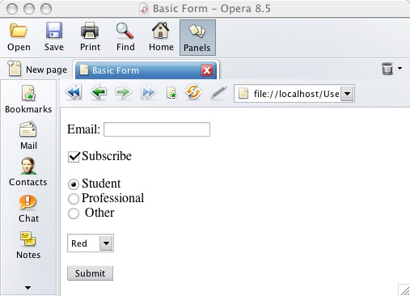
PHP - Dealing with the client
Text fields
Checkbox
Radio button
List boxes
Hidden form fields
Password box
Submit and reset buttons

Slide 53
PHP - Dealing with the client
<form method=“post” action=“file.php” name=“frmid” >
  Method specifies how the data will be sent
  Action specifies the file to go to. E.g. file.php
  id gives the form a unique name
Post method sends all contents of a form with basically hidden headers (not easily visible to users)
Get method sends all form input in the URL requested using name=value pairs separated by ampersands (&)
  E.g. process.php?name=trevor&number=345
  Is visible in the URL shown in the browser

Slide 54
PHP - Dealing with the client
All form values are placed into an array
Assume a form contains one textbox called “txtName” and the form is submitted using the post method, invoking process.php
process.php could access the form data using:
  $_POST[‘txtName’]
If the form used the get method, the form data would be available as:
  $_GET[‘txtName’]

Slide 55

PHP - Dealing with the client
For example, an HTML form:
  <form id=“showmsg” action=“show.php” method=“post”>
    <input type=“text” id=“txtMsg” value=“Hello World” />
    <input type=“submit” id=“submit” value=“Submit”>
  </form>

Slide 56

PHP - Dealing with the client
A file called show.php would receive the submitted data
It could output the message, for example:
<html>
  <head><title>Show Message</title></head>
  <body>
    <h1><?php echo $_POST[“txtMsg”]; ?></h1>
  </body>
</html>

Slide 57
PHP - Dealing with the client
Summary
  Form elements contain input elements
  Each input element has an id
  If a form is posted, the file stated as the action can use:
    $_POST[“inputid”]
  If a form uses the get method:
    $_GET[“inputid”]
Ensure you set all id attributes for form elements and their contents

Slide 58
PHP Introduction - Summary
Topics covered
  Server side architecture brief overview
  Basic PHP language topics
    Syntax
    Variables, Constants and Operators
    Decision making, IF and Switch statements
    Dealing with the client

Slide 59
Useful Links and Further Study
W3 Schools - http://www.w3schools.com/php/
PHP web site - http://www.php.net/
Choi, W. (2000) Beginning PHP4, Wrox Press, ISBN: 1-861003-73-0
http://www.fcet.staffs.ac.uk/tja1/
  Web site will be updated before accompanying tutorial session
  Will contain a useful supplement to tutorial content

